Slide 1

User Interface

Slide 2
Use the previous Project
You don’t have to as we can simulate stuff happening with keypresses but if you use an existing project you’ll see a game really coming together.

Slide 3
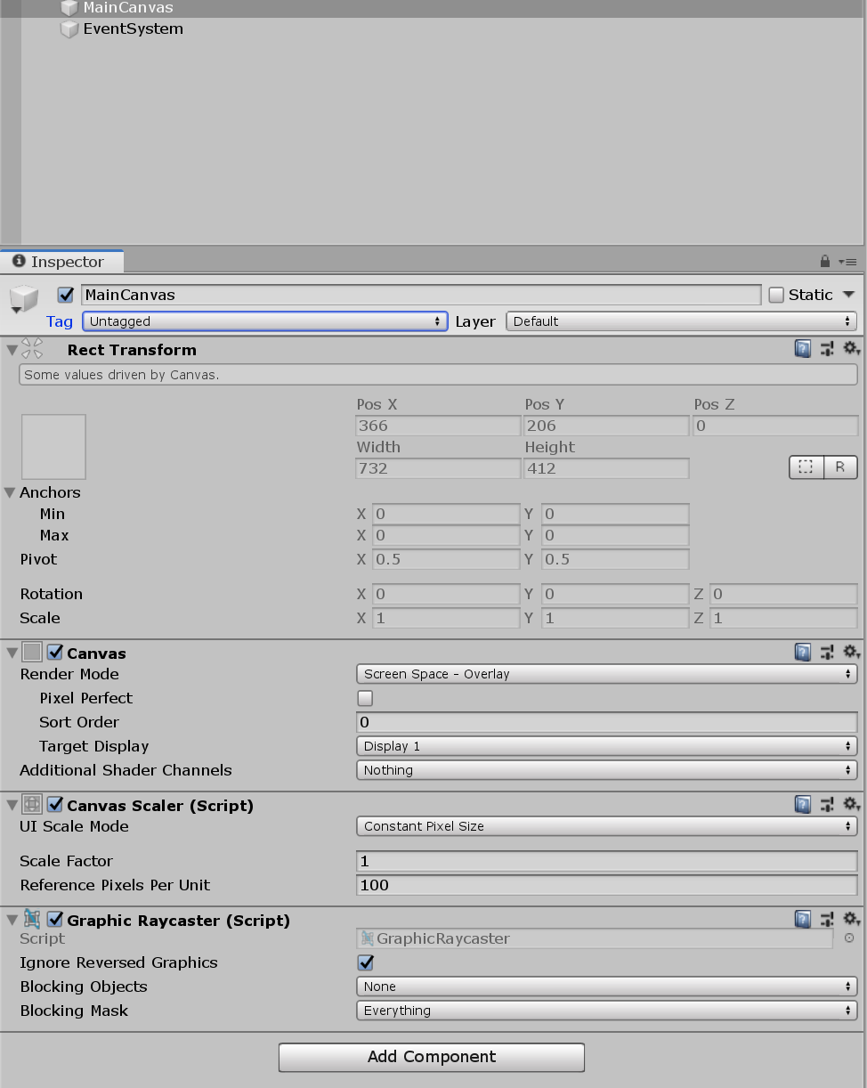
The canvas
Right click the hierarchy and go to UI in the dropdown and select Canvas.
A canvas is the base UI object that represents your screen space.
When you do this an EventSystem object will be created automatically. Do not delete this, it’s necessary to register UI events.

Slide 4
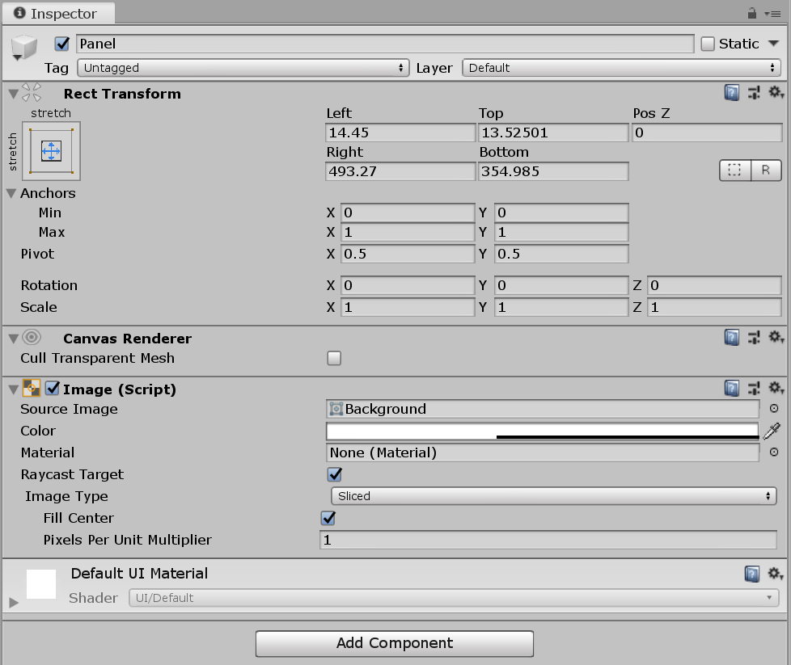
Panels
Panels are the most basic natural subdivision for organising the UI.
Think of it as a div in HTML. A container that can be moved or flexed to fit requirements.
UI elements like the panel have a Rect Transform
You can edit this in the scene view by using the Rect gizmo on the top left

Slide 5
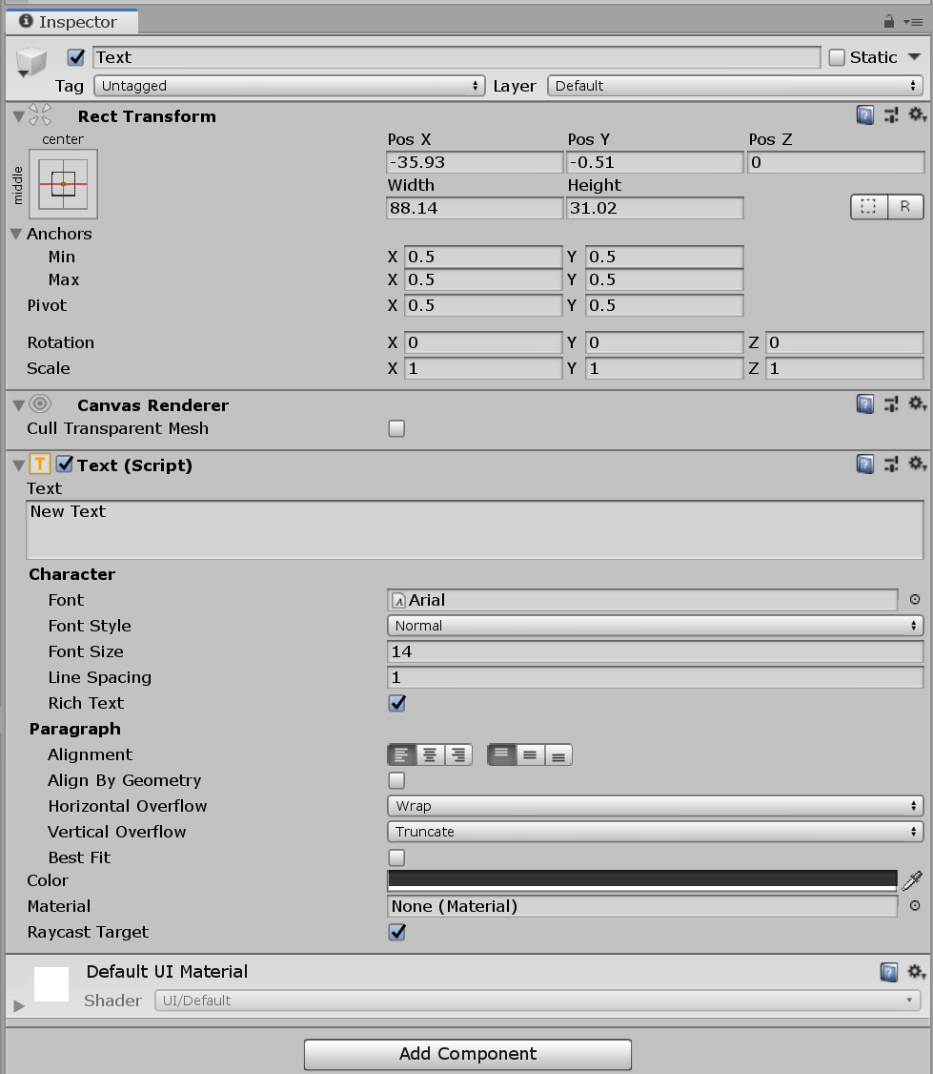
Text
Simply show strings on the screen.
Right click the hierarchy and under UI find Text
Place this as a child of your panel.
Rich text allows you to embed information like colour or italics using HTML tags.
Try <color=green> Hello</color> <color=red> World</color>
Ameican spellings are unfortunately necessary.
The overflow dropdowns determine if the text is allowed to run outside it’s box if too large or if it get cut off instead.
You may see the option for a Textmesh Pro text object. Ignore that for now. That’s a text object with a lot more power but too much detail to work with right now.

Slide 6
Accessing elements from code
We don’t want every scene to have many objects making separate calls to many UI elements.
We’ll have a UI manager class whose sole responsibility to to take requests from objects and change the UI or from UI elements and pass them where they need to go.
We’ll use a simple implementation of the Singleton design pattern to achieve this.
The singleton pattern lets us guarantee there is one and only one instance of the manager object persisting throughout the game.

Slide 7
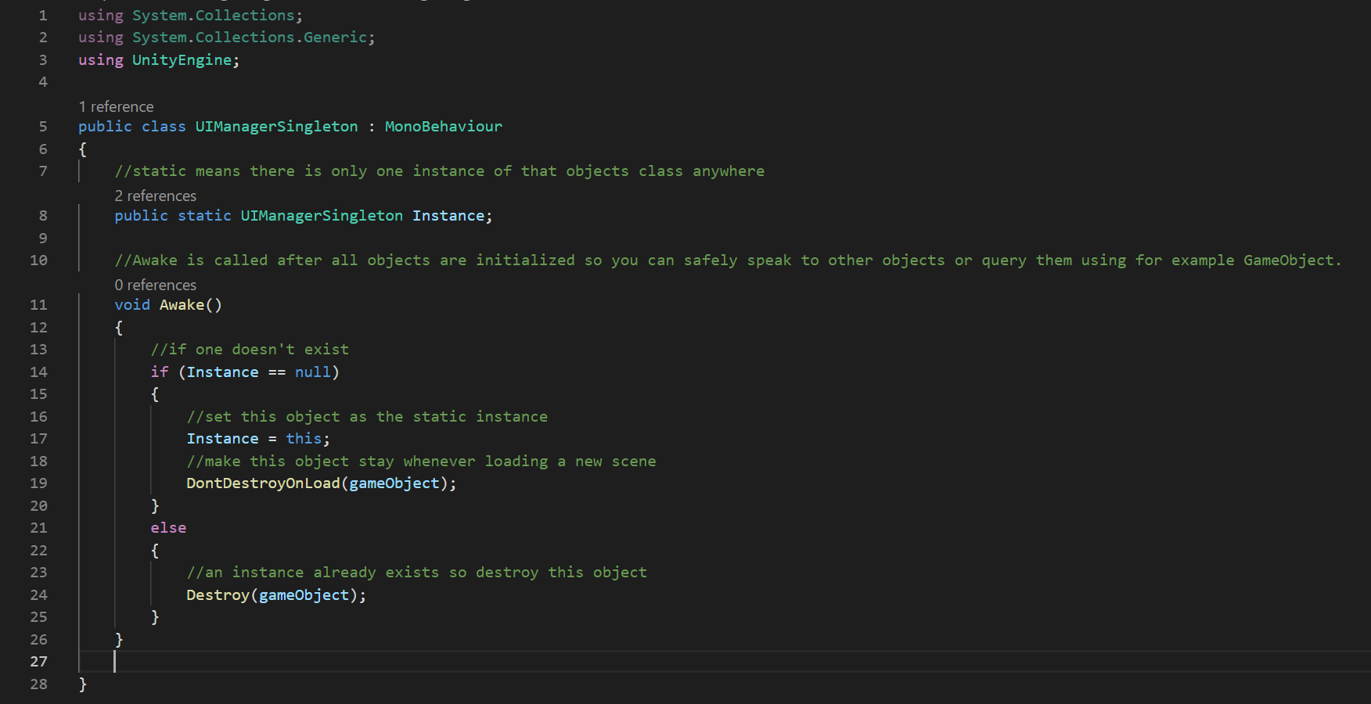
Singleton setup
We want to make sure the is only one of something which anything can access if it has to.
The static keyword allows us to have objects which are the same everywhere they are used. If you change the value in one place it changes everywhere.
Public allows other scripts and Unity’s button system to call functions belonging to the instance.
DontDestroyOnLoad() marks a GameObject to persist to other scenes when changing between scenes.

Slide 8
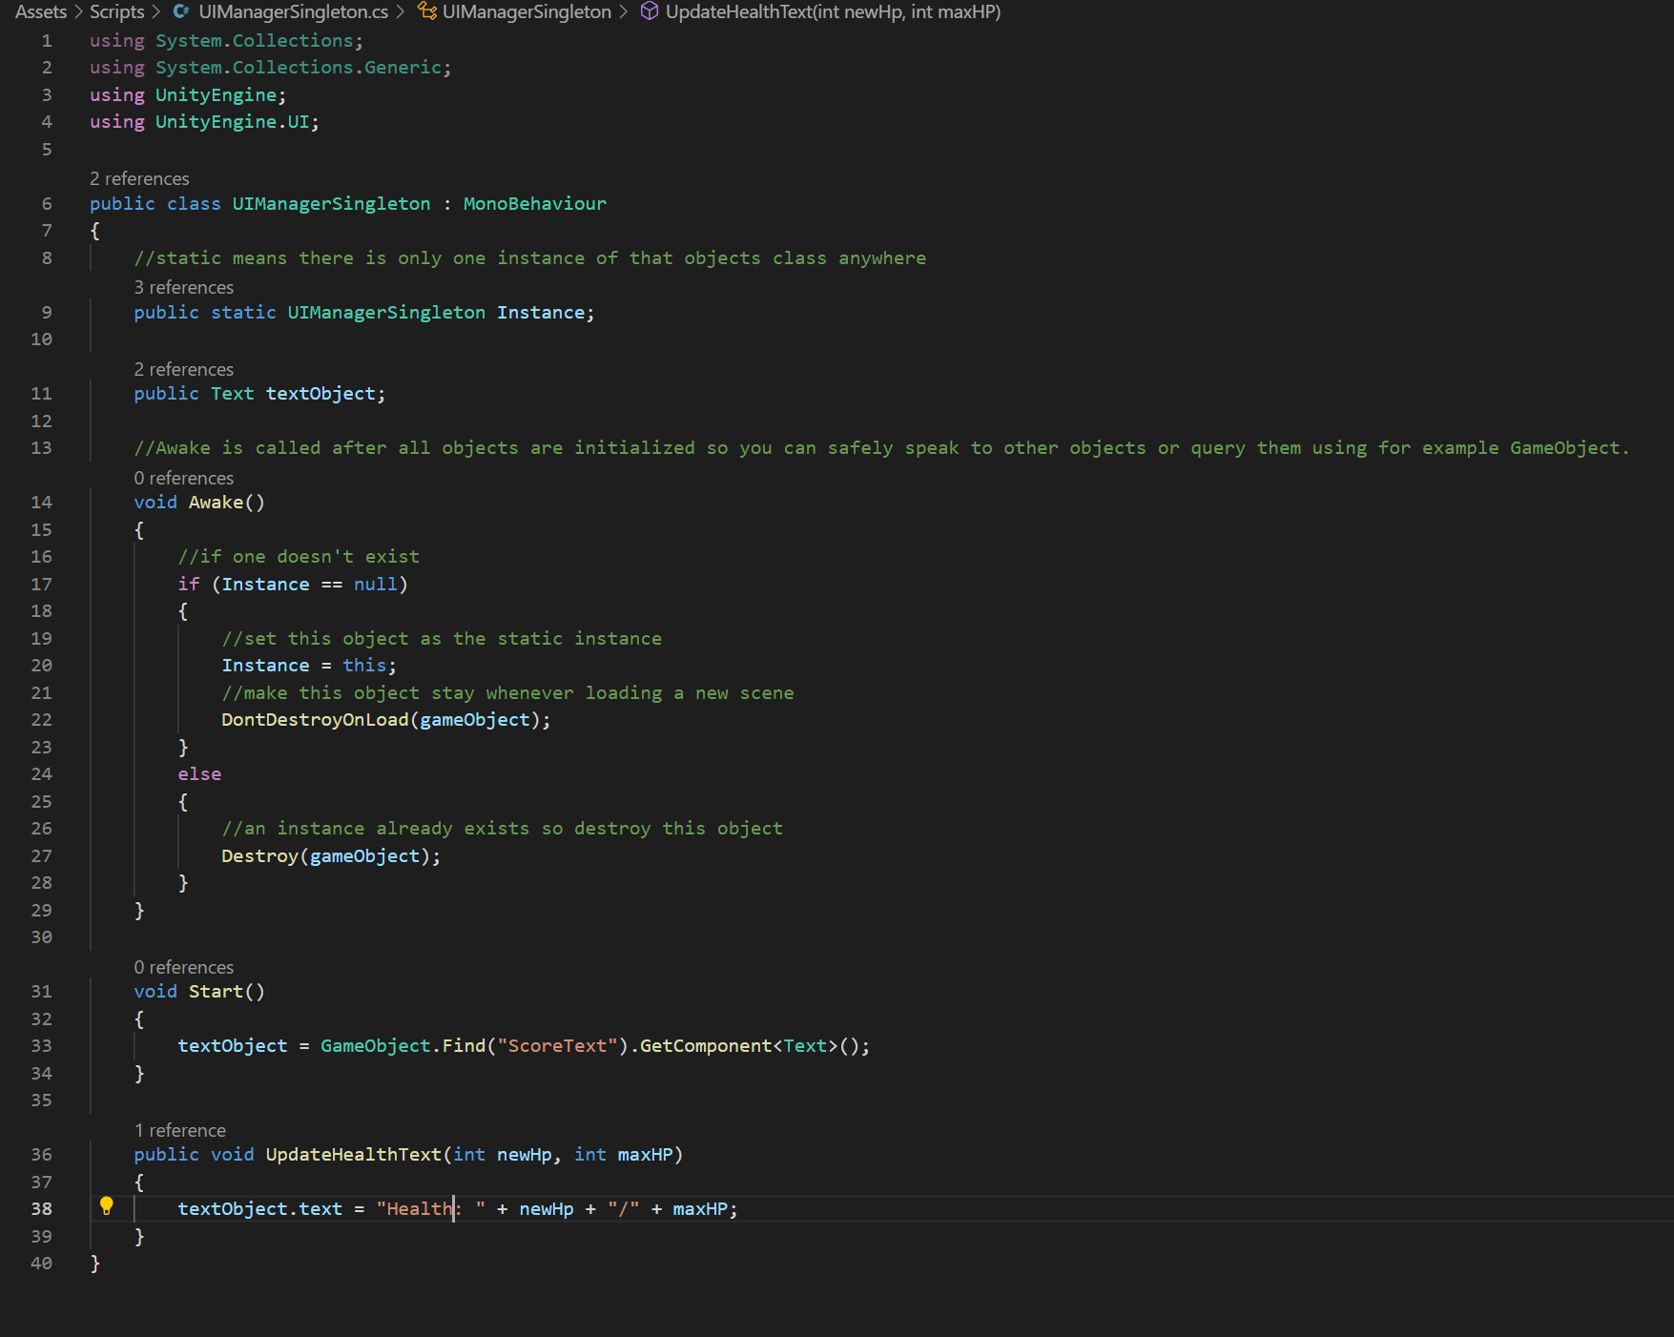
Public functions to change things
We can write a function to update our text.
Remember to use the UnityEngine.UI namespace.
I’m going to have a public Text object that I find by name on start.
I’m going to make it a health indicator.
I can now update the health/score/whatever from anywhere.
You may want to make it a health tracker if you didn’t get as far as shooting things last time or simply bind it to an input.

Slide 9
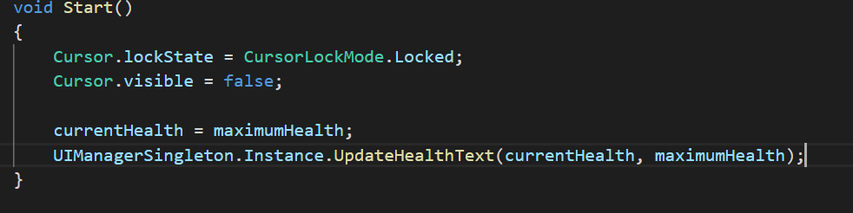
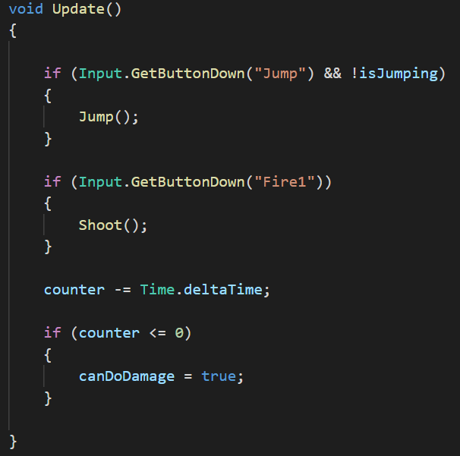
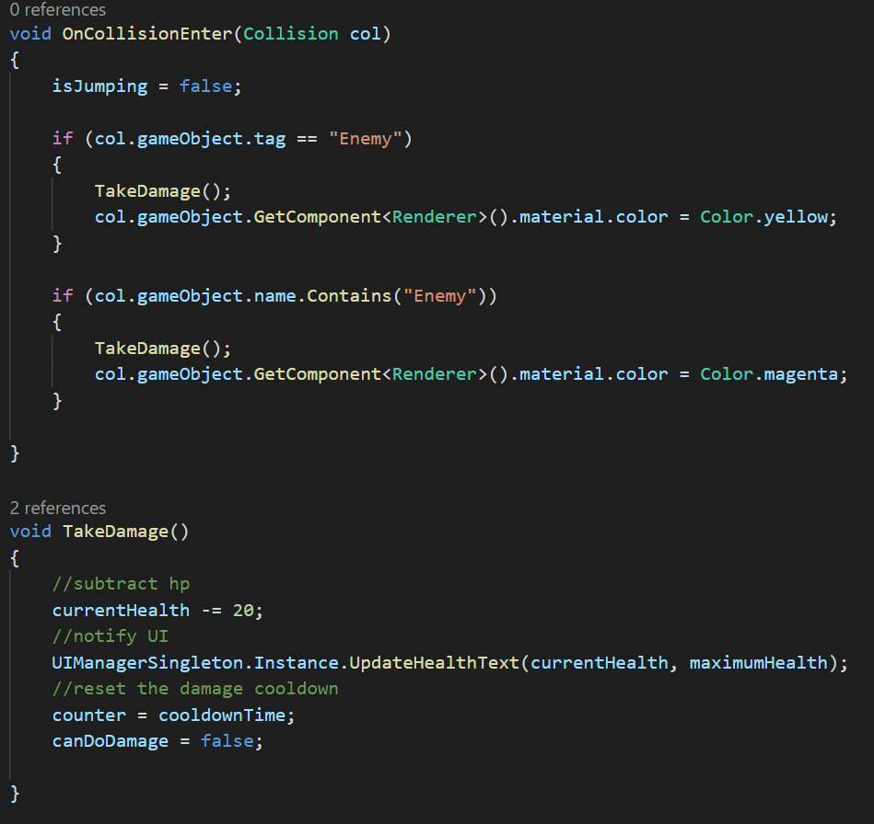
Accessing this function
Easy one-liner.
On start the player tells the UI it’s health.
I use a timer to subtract health ever 2 second I’m on the death zone.
Every time that happens I deal damage to the player.
The player then reports its updated health the UI.

Slide 10
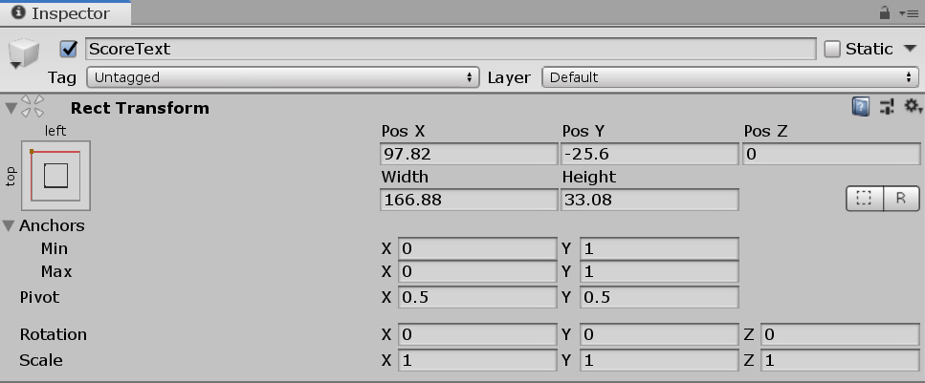
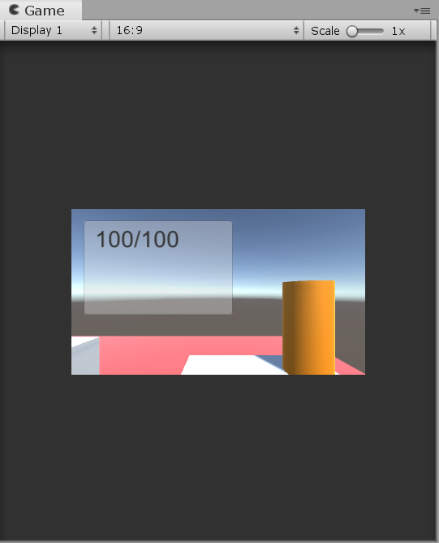
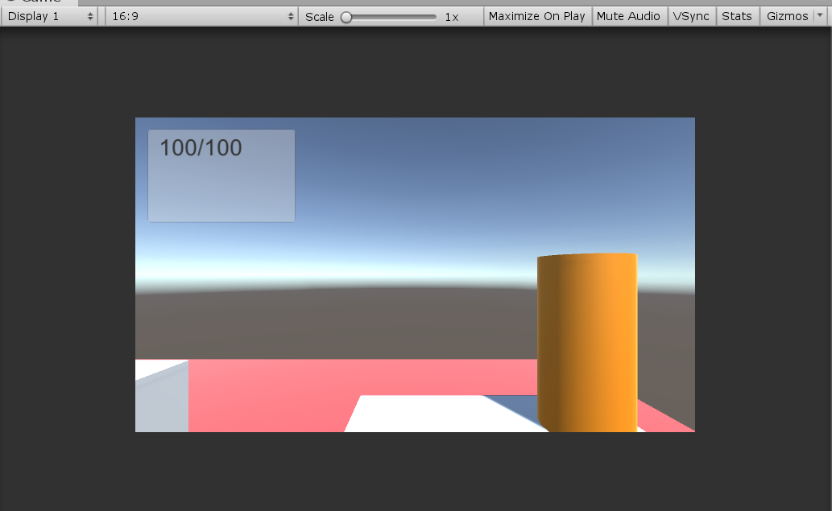
Anchors
You’ll notice your UI elements move around to different positions if you scale the screen.
A way to address this is to use anchors to determine where they go.
This example shows the panel and the text anchored to left.
This introduces a scaling problem.

Slide 11
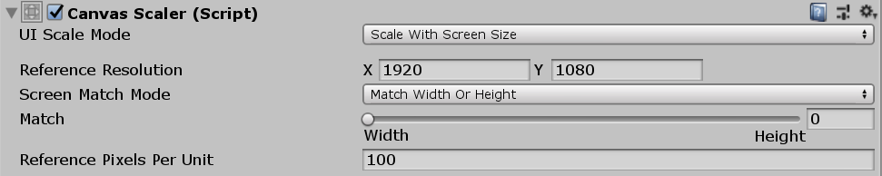
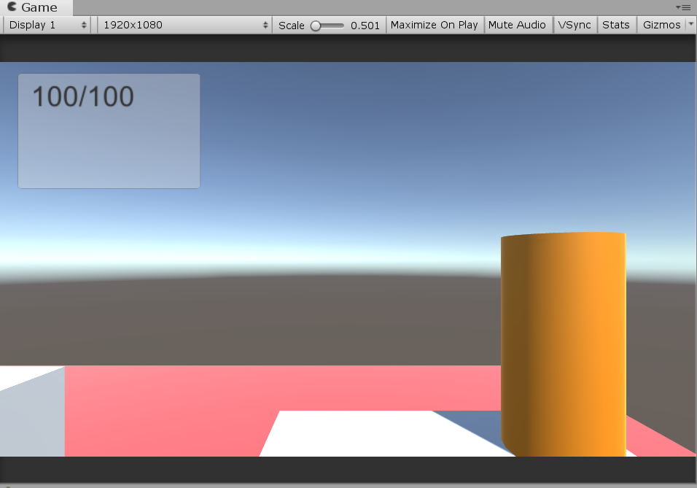
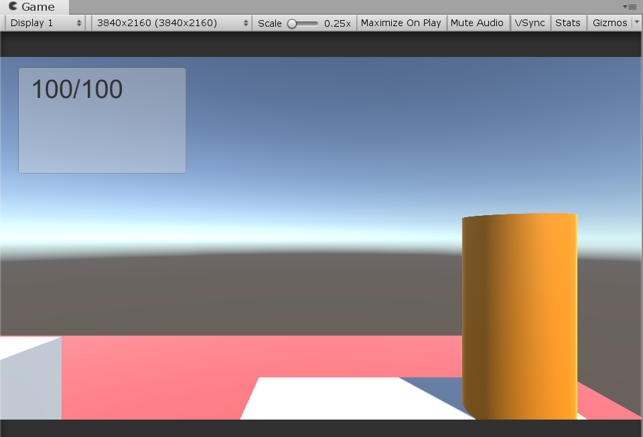
Scaling
In the base canvas we can use the canvas scaler so that at any resolution the UI looks the same as it would at your chosen resolution.
If it goes blurry it’s because your game view is in 16x9 mode. Change it to a custom size and give it pixels width by height you want to test.

Slide 12
Images
Unlike the Unity 2D system (I’ve unfortunately not had time to show you yet), the UI does not use the sprite format of graphic asset. It is referenced as an Image type.
Create one in the hierarchy and add an image file. Doesn’t matter what. Preferably something small. I actually like to got to paint and make a 1x1 pixel white dot because it can be very flexible. Make sure when you import your graphic to select “2D and UI” from the “texture type” dropdown.

Slide 13
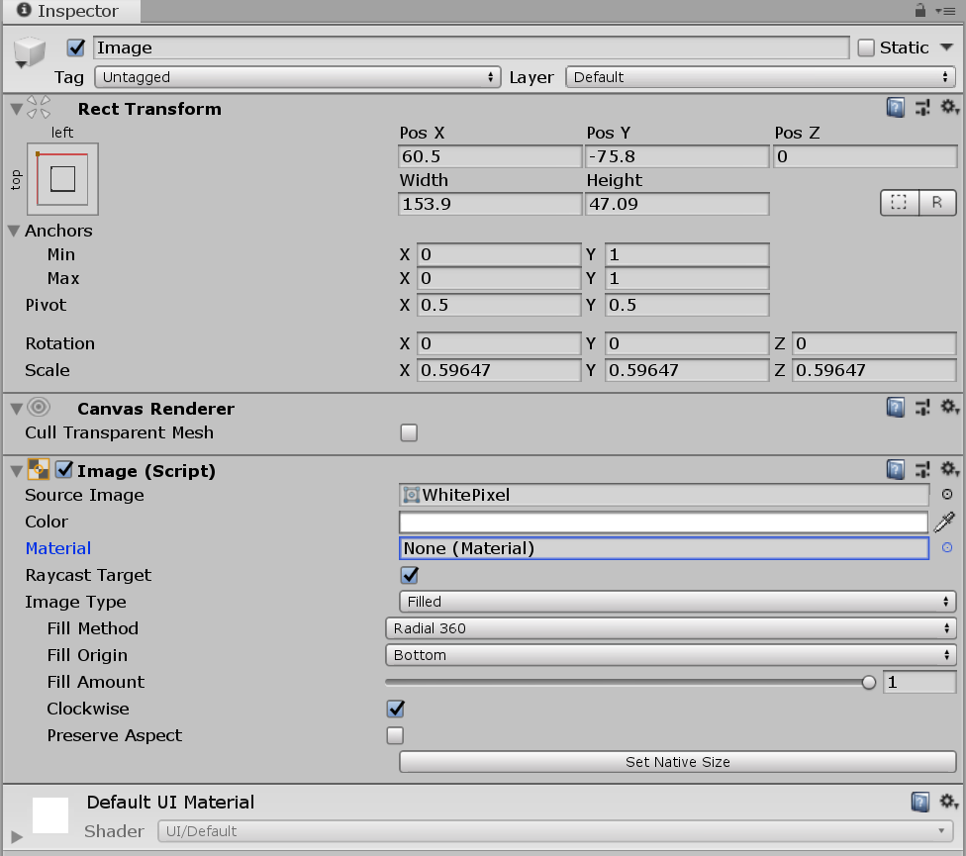
Healthbars
Make a second image on top of your original image.
Set image type of the top one to filled and change it’s colour.
You can see the effect of dragging the fill amount slider.

Slide 14
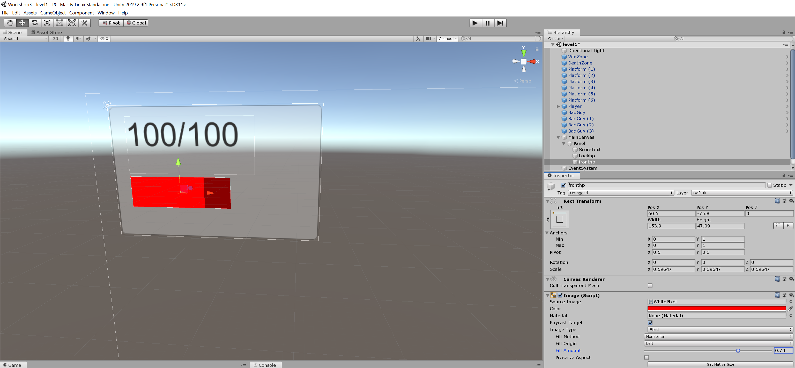
Horizontal
Use horizonal fill style on the top one to make a sliding health bar.

Slide 15
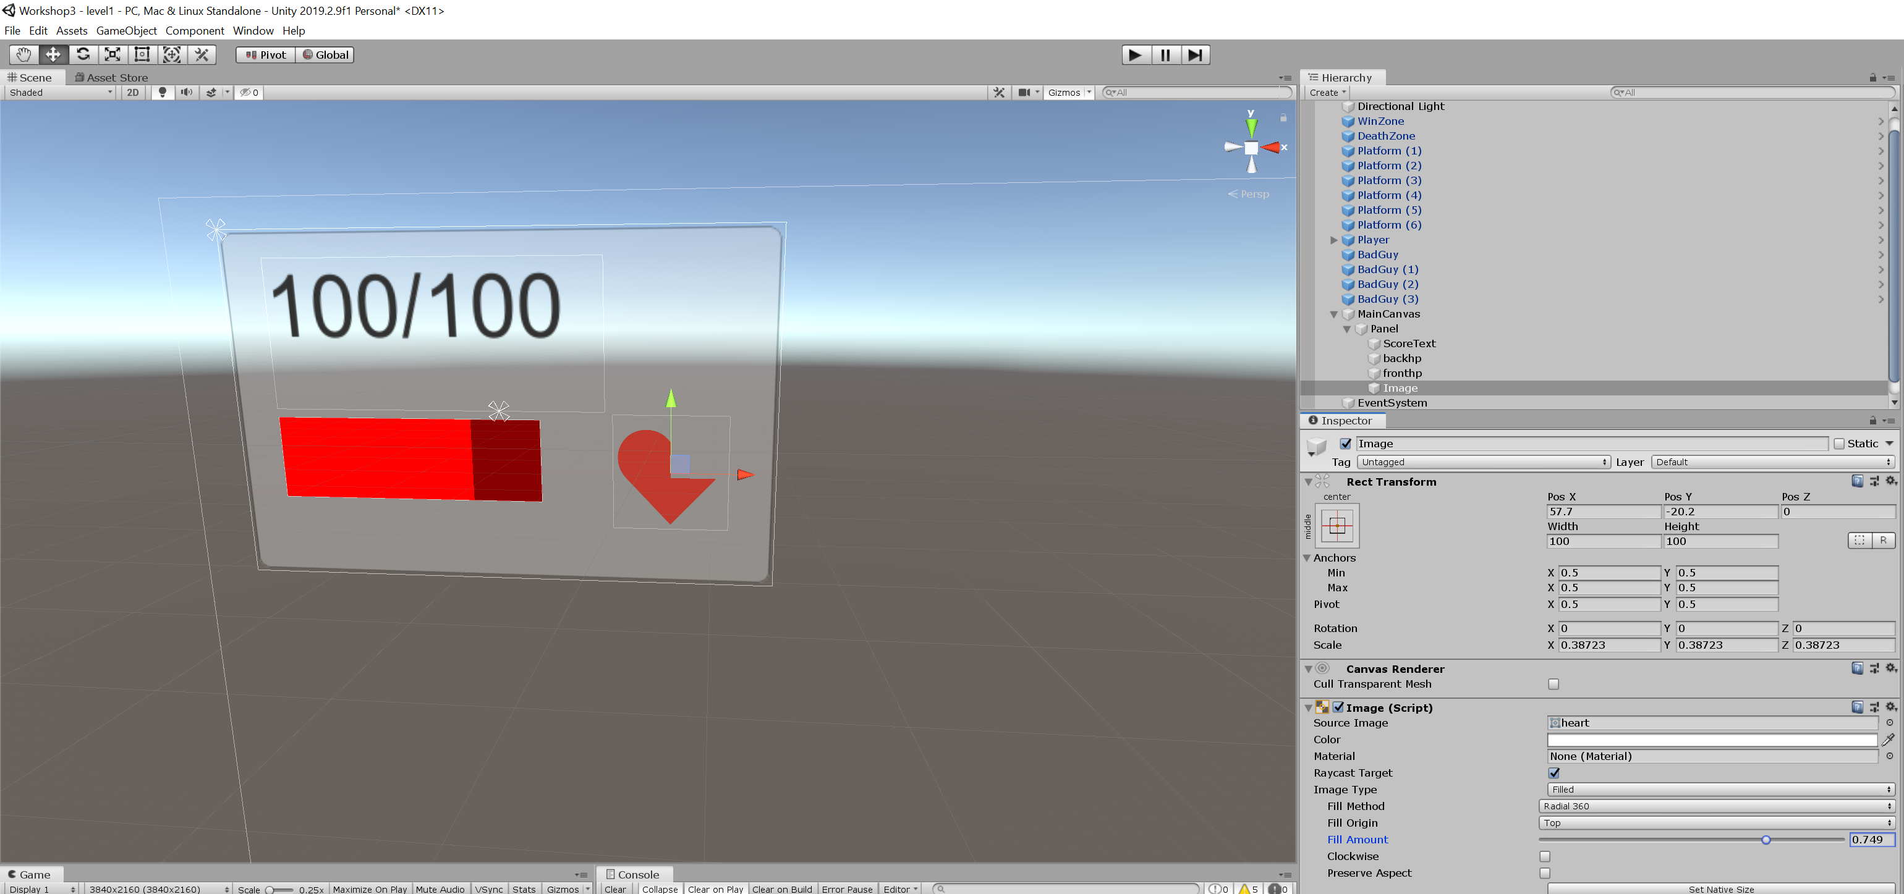
Radial
An image can be filled radially to get an effect like Link’s hears in Zelda Breath Of the Wild.

Slide 16
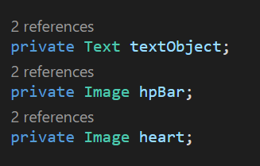
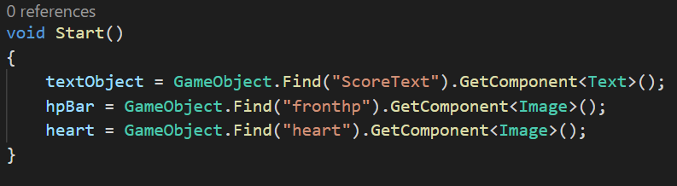
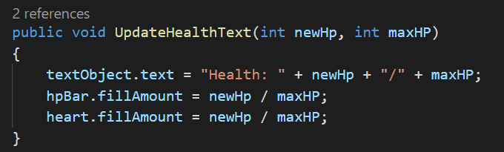
Simple Addition in code
Add your image variables.
Set your references.
Set the value equal to your hp as a percentage of your max (between 0 and 1)

Slide 17
Contacts
Daniel “Dan” Korsah : 40214314@live.napier.ac.uk
Krzysztof “Kris” Czerwinski : 40283208@live.napier.ac.uk
Complaints to Thomas “Tom” Methven : T.Methven@napier.ac.uk

